Slide 1

NAEP Test Scores and Funding
By Teresa Cameron, John Light Jr, and Tyler McAfee

Slide 2

Preparation
The National Assessment of Educational Progress (NAEP) is a congressionally mandated project that is administered by the National Center for Education Statistics (NCES). The same NAEP assessment is administered in every state providing educators, policymakers, and parents with a common measure of student achievements.
Institute of Education Sciences National Center for Education Statistics. (2019). An Overview of NAEP. Retrieved from https://nces.ed.gov/nationsreportcard/subject/about/pdf/NAEP_Overview_Brochure_2018.pdf

Slide 3

Dataset
URL for Dataset: https://www.kaggle.com/noriuk/us-education-datasets-unification-project
The dataset contains the enrollment number, amount of federal, state, and local revenue, amount spent on instruction, support services, capital outlay, and other expenditures, and the average reading and math NAEP scores for fourth and eighth graders by state every other year starting from 2003 to 2015.

Slide 4

Questions
What is the average percent distribution of federal, state, and local revenue by state?
What is the average amount of expenditures spent per student by state?
What is the average test score for 4th and 8th grade by region?
Do these variables effect test scores?
Do these variables predict above or below average test scores?

Slide 5
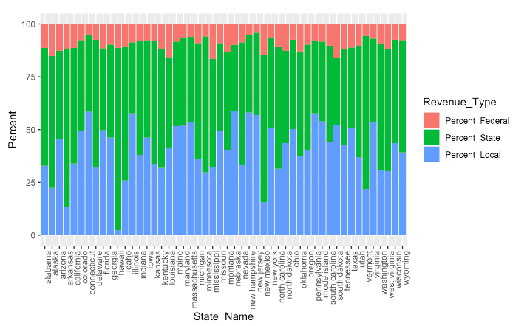
Percent Revenue Distribution by State
 | Federal | State | Local
Min | 4.1% | 31.6% | 2.3%
25% | 7.6% | 40.8% | 32.5%
Mean | 9.4% | 46.2% | 42.0%
75% | 11.8% | 57.2% | 50.9%
Max | 16.5% | 86.4% | 58.5%

Slide 6
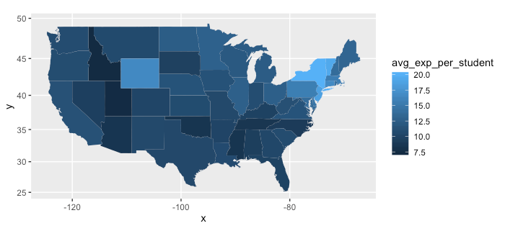
Average Expenditure per Student by State
Min | $ 7.34
25% | $ 10.09
Mean | $ 11.00
75% | $ 13.10
Max | $ 20.07
Idaho
New York

Slide 7

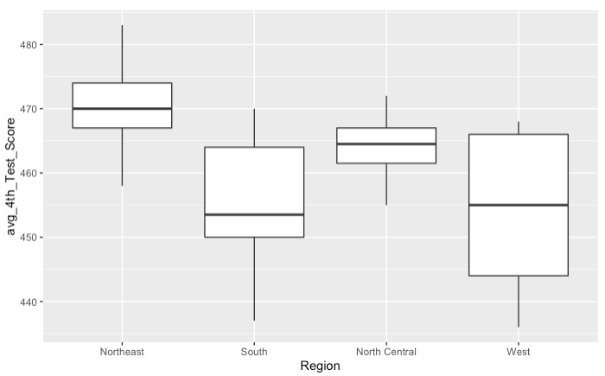
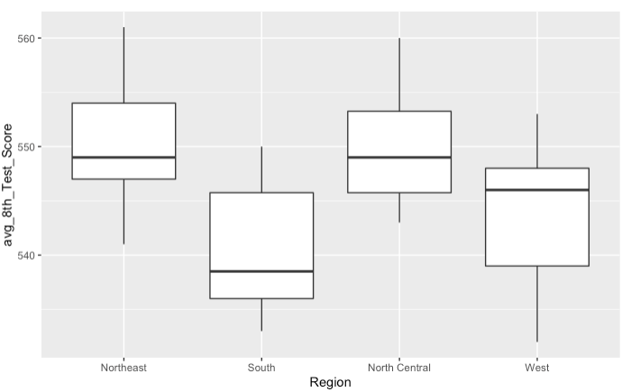
Average Test Scores by Region
Average 4th Grade Test Scores
Average 8th Grade Test Scores

Slide 8
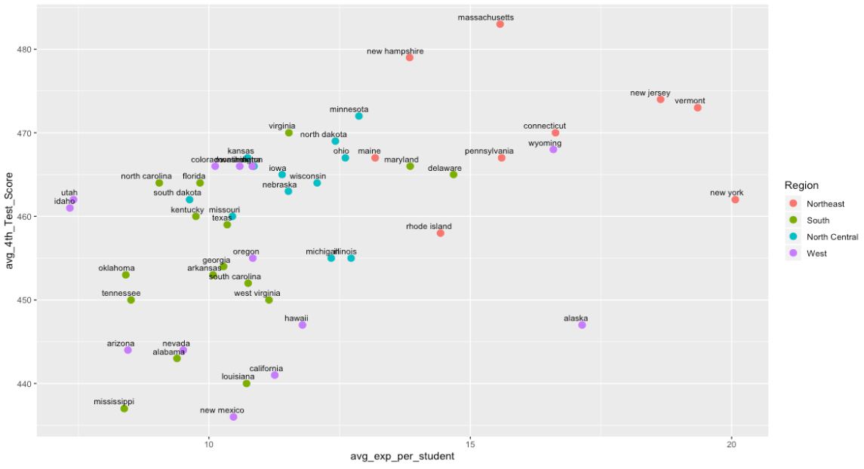
Average 4th Grade Score by Expenditure per Student

Slide 9
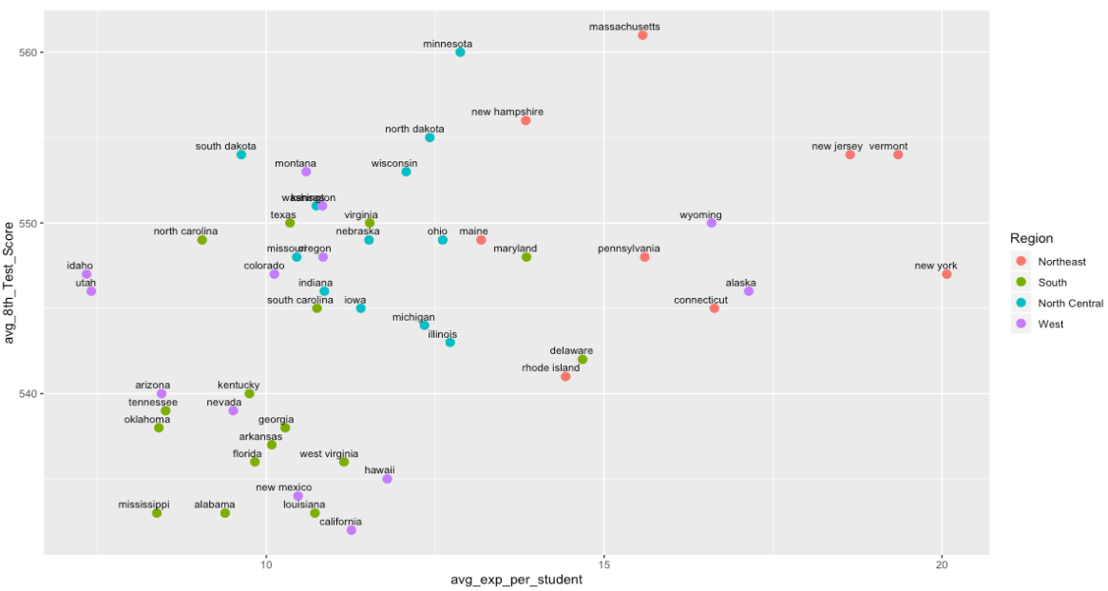
Average 8th Grade Score by Expenditure per Student

Slide 10

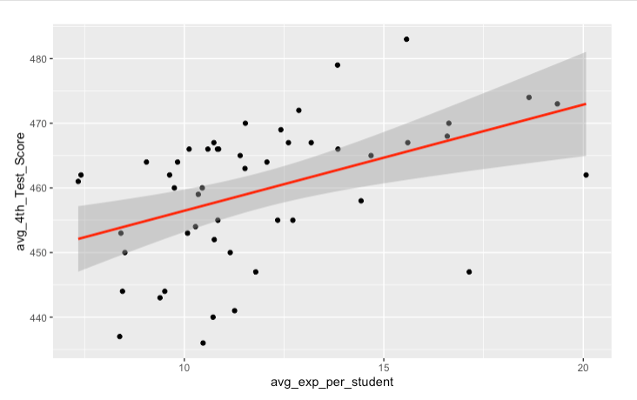
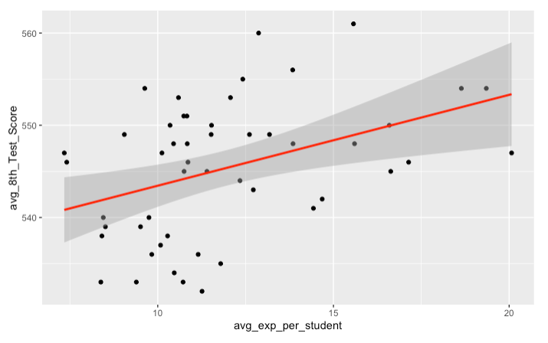
Linear Model Scatterplots
Total Average Expenditure per Student

Slide 11
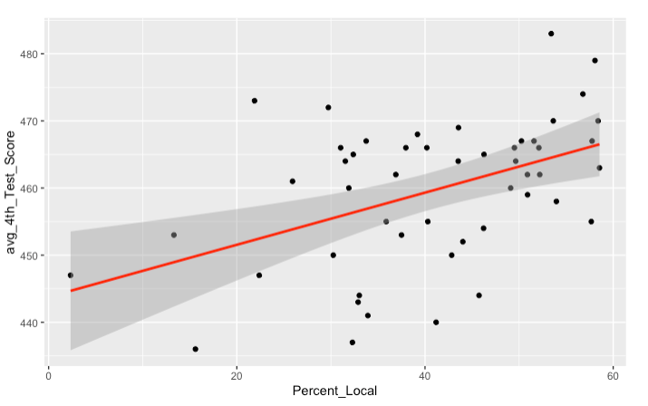
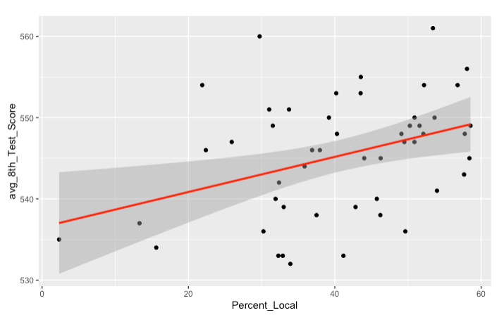
Linear Model Scatterplots
Percentage of Local Revenue

Slide 12
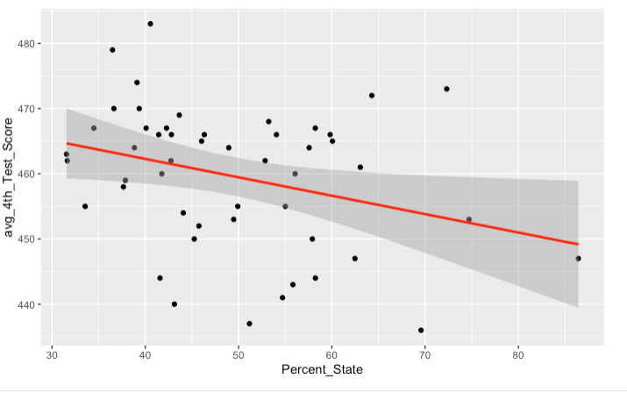
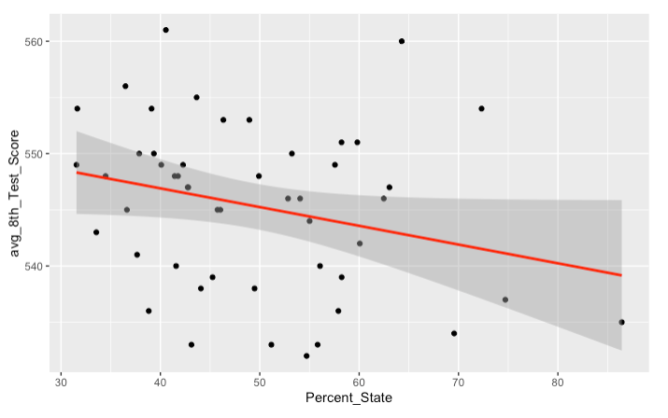
Linear Model Scatterplots
Percentage of State Revenue

Slide 13

Can we predict above or below average test scores?

Slide 14

Support Vector Models
We created a model that would try to find patterns of predicting above or below average test scores within the data by examining a portion of the data. Then we tested the model using the remaining data. The model had an accuracy rate of 62% for the 4th grade test scores and 70% for the 8th grade test scores.

Slide 15

Conclusions
Here are some of the interesting conclusions from this data set:
There seems to be a correlation between local percent revenue and test scores. The 4th and 8th grade scores tend to increase as local percent revenue increases.
However, as state revenue percentages increase the state scores decrease. This leads us to believe local control over revenue may lead to an increase in scores.
In all our models, the Northeast region spends the most revenue and expenditures per student. They also have the highest scores across both grade levels. This seems to follow a logical plan until...
We see the West and the North Central have similar scores without spending as much per student. As a matter of fact, if it were not for California, New Mexico, Arizona, and Nevada, the West's median score could be as high or higher than the Northeast. However, cost of living may be a factor.
This leads us to infer there are competing variables outside of this data set that better influence test scores than revenue and expenditures.

